Slide 1
Simulating a touchscreen using distance sensors
Luiz Fernando Eugenio、佐々木凪、Mamanchuk Mykola

Slide 2
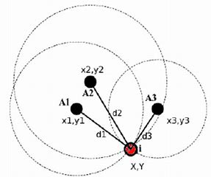
abstract
２つの距離センサー、そして三辺測量と呼ばれる手法を用い物体のxy座標を取得できる
↓
手のxy座標を取得し遠隔操作可能なタッチスクリーンとしてシミュレート

Slide 3

Background
What if we can operate anything from afar, as if we are using a touchscreen?
We made simple app as a proof of concept. The user interacts with the app using only the hand position calculated using the sensors’ data

Slide 4
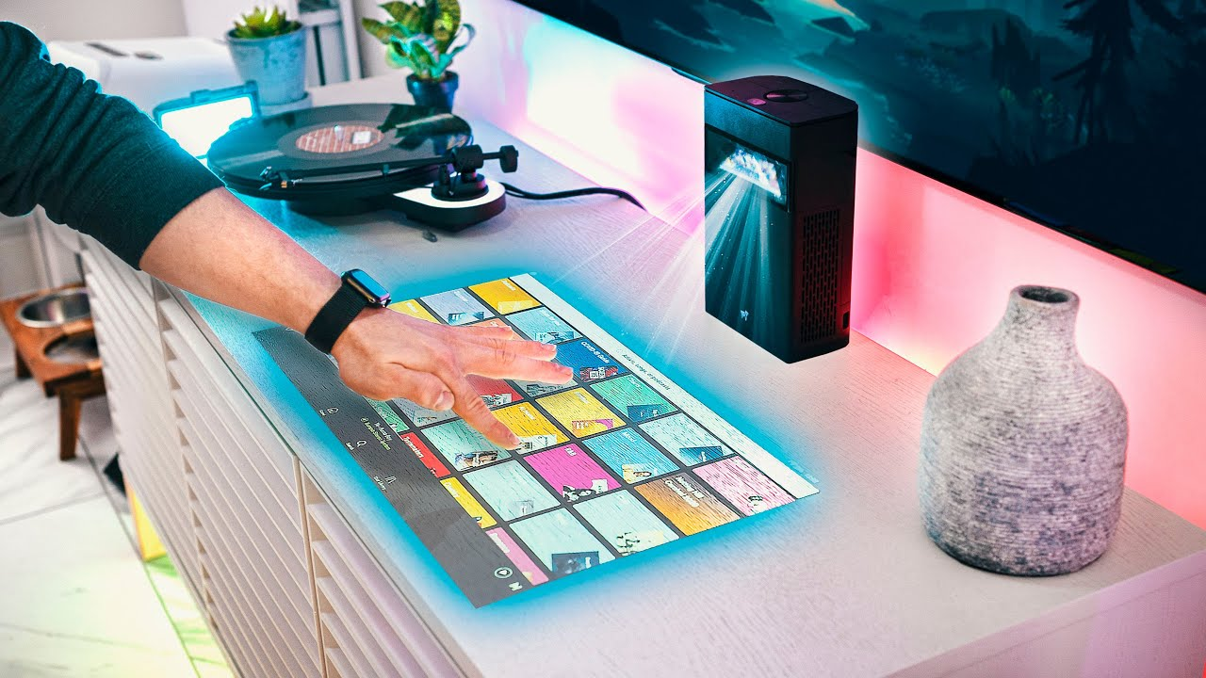
Current technologies
Similar implementations exist, but they use very expensive laser technology

Slide 5
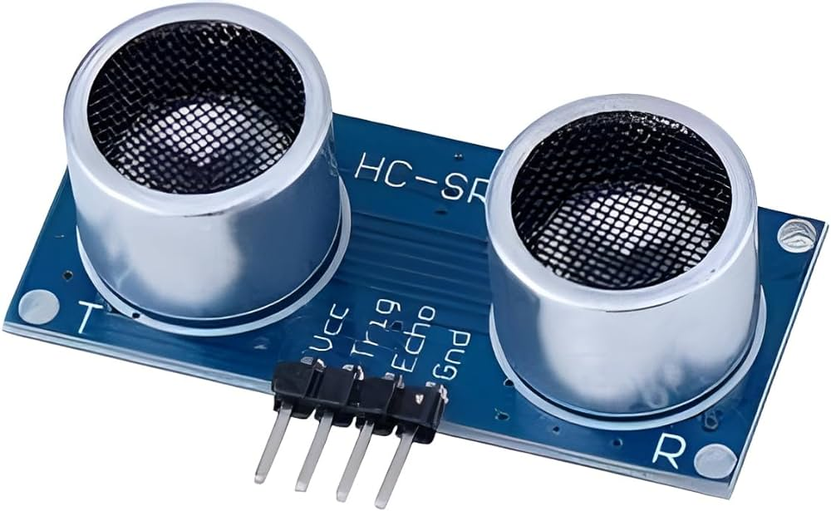
Our system
We use two cheap and easily available sensors (HC-SR04) to achieve the same results.

Slide 6
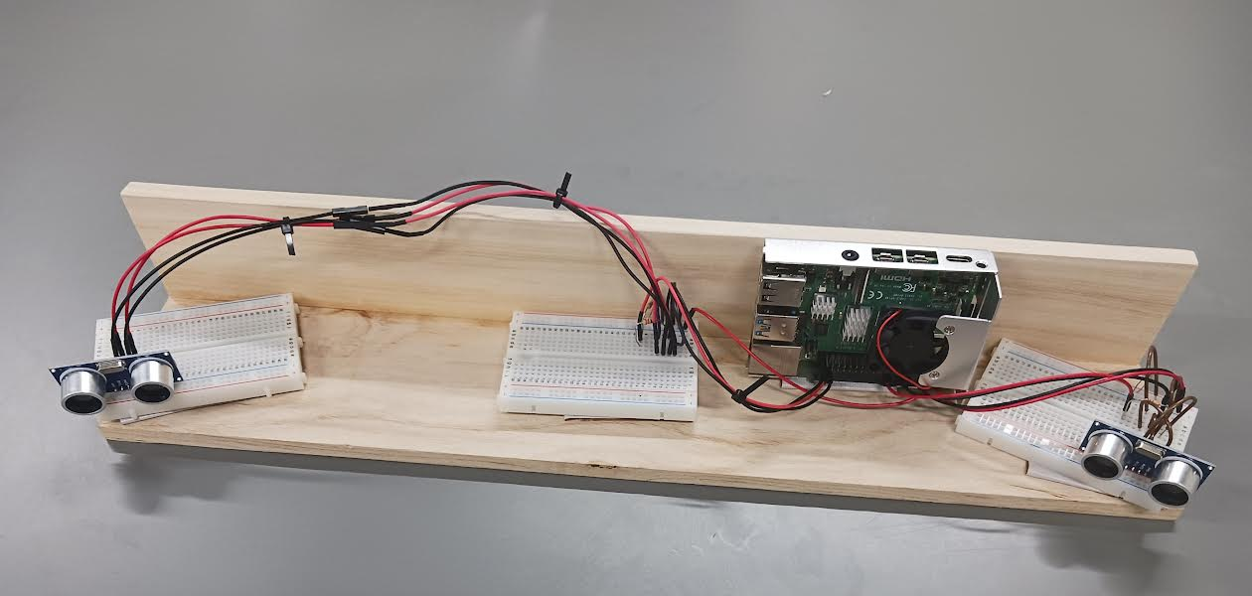
Implementation(実装)
Raspberry Pi and two HC-SR04 ultrasonic distance sensors are used in the following setup:

Slide 7
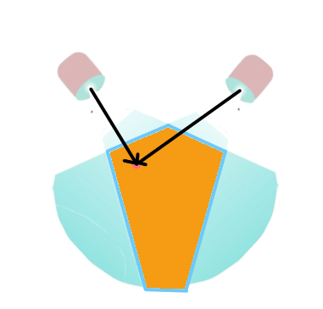
Implementation(実装)
Knowing only the distances from the sensors, trilateration
(三辺測量) can be applied to get the position
Our system makes it even simpler. By restricting the FoV, we can reduce it to only two sensors

Slide 8
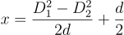
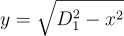
Implementation(実装)
We set the first sensor’s position at (0,0) and the second at (0,d)
Distances D1 and D2 are measured from the first and second sensors
We calculate (x,y) by doing:

Slide 9
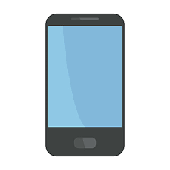
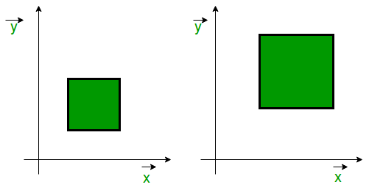


Implementation(実装)
Once the app is obtaining the distance position from the sensors, we can make a calibration to map the points (x,y) to pixels in the screen

Slide 10
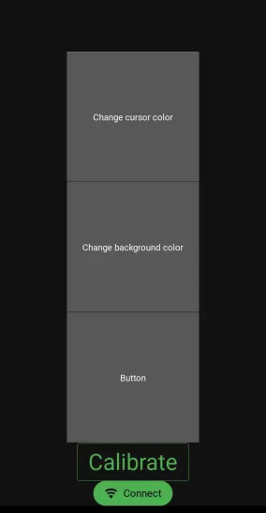
How to use
Connect to the same network as the Raspberry pi and open the app
Click the “connect” button to start receiving data

Slide 11
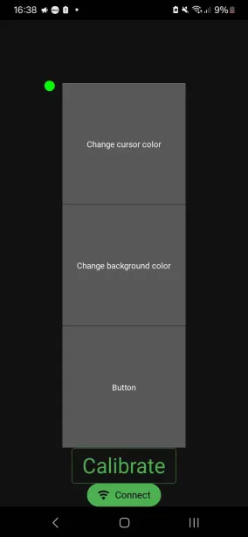
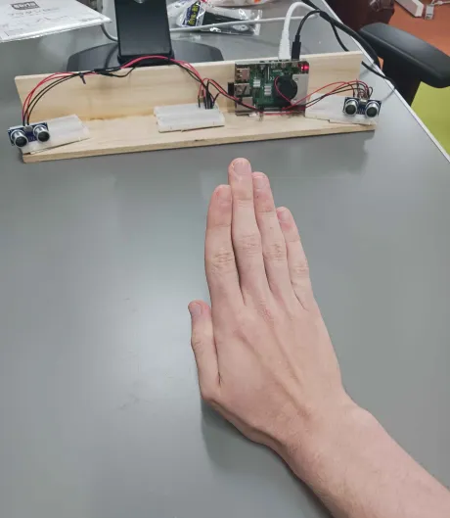
How to use
You will now be able to see the “cursor”
Move your hand in front of the sensor to see the cursor moving with it

Slide 12
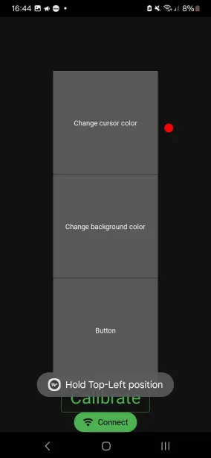
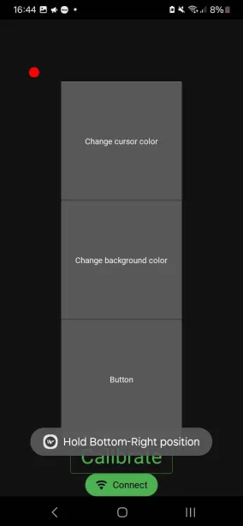
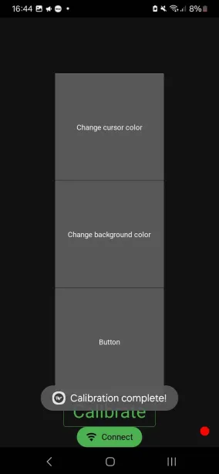
How to use
Calibrate the sensors to your screen
Choose the upper-left and bottom-right corners of the surface you want to use as your screen

Slide 13
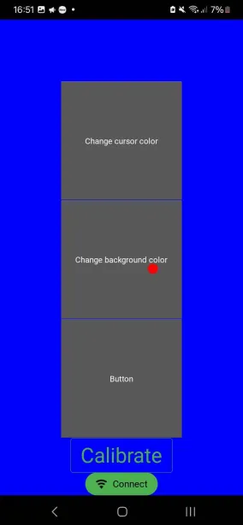
How to use
Use your hand position to control the cursor on the screen;
“Click” the buttons by hovering over each button for a few seconds.

Slide 14
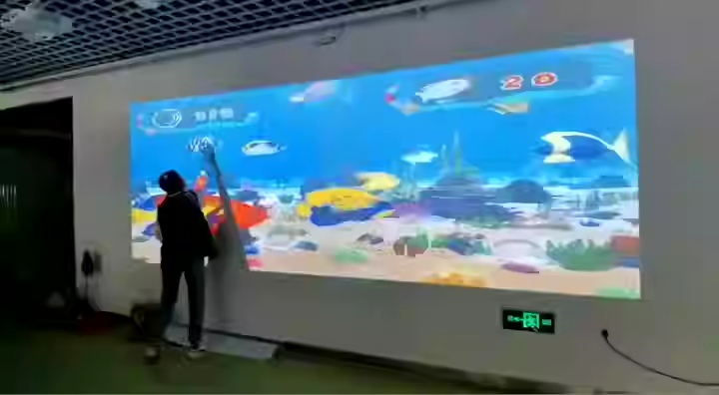
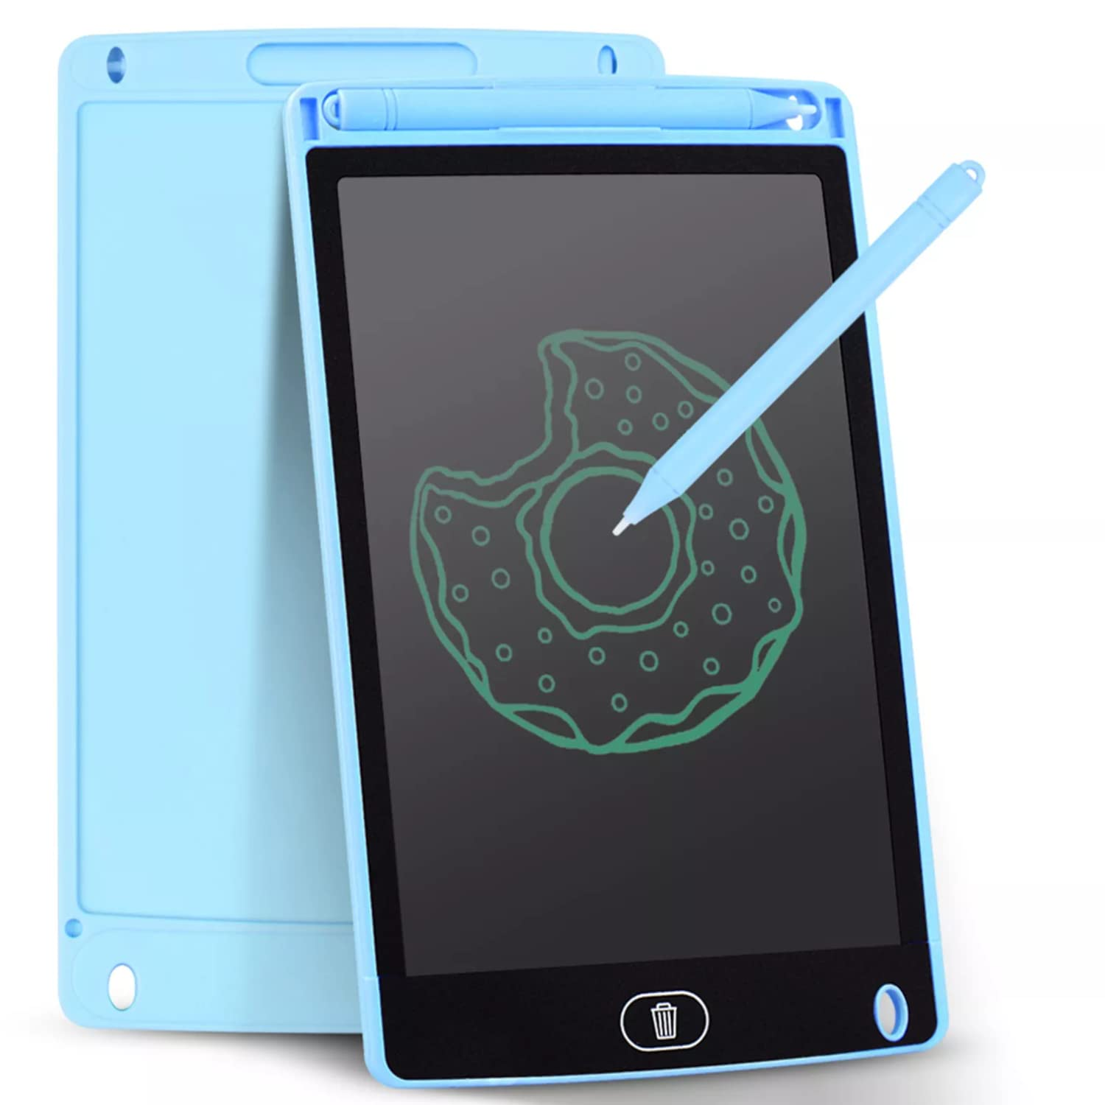
Things to improve
The most important variables for this project are the sensor’s Field of Vision (FoV) and precision;
If we have good enough sensors, theoretically we can achieve results equivalent to tablets or even big screens for a fraction of the price

Slide 15
Thank you for listening!

